Slide 1
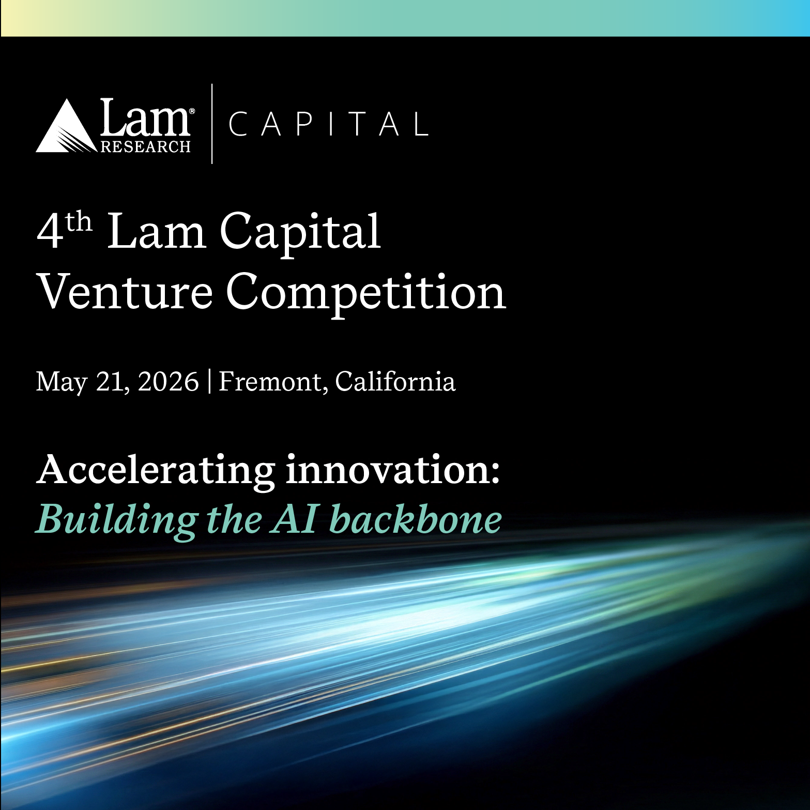





Welcoming global deeptech innovators
Connect with distinguished investors & industry leaders, and compete live for $250,000 investment
Apply by March 15!
Semiconductor fabrication & advanced packaging
Novel materials, photonics, and next-gen compute
Robotics & advanced manufacturing
Scientific, industrial, and physical AI innovations

Slide 2
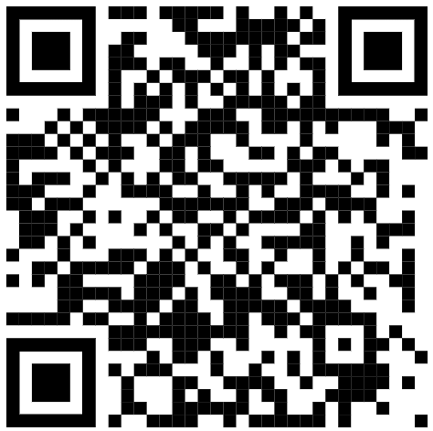
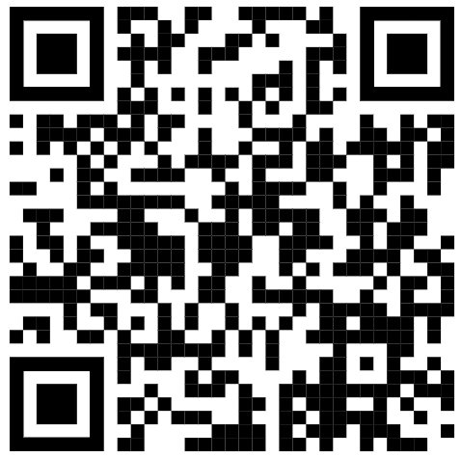
4th Lam Capital Venture Competition – Resources
Follow us on LinkedIn to never miss an update
https://www.linkedin.com/company/lam-capital/
Event web page
2026 Lam Capital Venture Competition - Lam Capital

